Slide 1
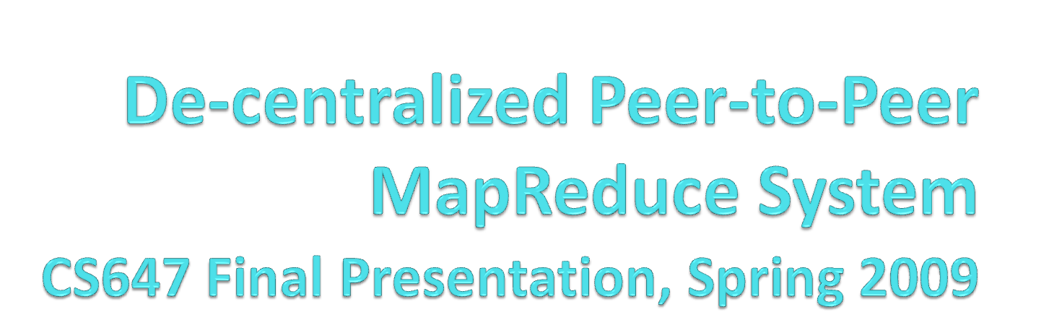
Omar Badran
Jordan Osecki
Bill Shaya

Slide 2
Overview
Introduction
Background
Approach
Evaluation
  Demo
Related Work
Conclusions
References

Slide 3
Introduction
Typical MapReduce Systems are comprised of a group of servers housed at a single location
Characteristics:
  MapReduce jobs are limited to running on those servers
  MapReduce systems typically have only one “master” and several “worker” nodes that perform the map and reduce functionality
  The “master” coordinates the MapReduce operation while the workers actually perform parts of the job

Slide 4
Introduction
Pitfalls of the “typical” MapReduce:
  All jobs that are run are decided within that server room
  The jobs can only utilize those resources available in the area
  The whole system is dependent on the single “master” for coordination
  The job is dependent on all of the “workers” doing their job
  It is difficult to switch the role of a node in the process even if new roles would dramatically increase the efficiency of that job
  It is not very good at reacting to failures, which will most likely need human intervention to resolve them

Slide 5
Introduction
  Proposal: the development of a simulated MapReduce system over a de-centralized Peer-to-Peer (P2P) network
  Benefits:
    This system will have the ability to have access to numerous servers that are connected to the Internet for both extra computational ability and job submission.
    The de-centralized approach will allow any peer node to act as the “master
    There will no longer be a dependency on any one “master” or any “workers”, as new “masters” can be appointed from the general node mass and new “workers” can be found to replace any that may have been disconnected.

Slide 6
Introduction
Benefits (continued):
  No “workers” will be overburdened, as there will be enough to split up the task into the ideal chunks necessary, choosing the ideal “workers” for the job
  This system will employ two self-* innovations in order to further improve the MapReduce experience.
  All of these changes will make for a more open, efficient, utilized, robust, and reliable system overall than the traditional MapReduce system

Slide 7
Background
MapReduce systems are used for very large jobs that in some way have tasks which can be performed independently of each other.
A simple example of this is counting words in a file or counting occurrences of a word or other traits or characteristics in a file. This is purely a parallelizable job with each portion independent because no results depend on any others.

Slide 8
Background
Although this is a trivial job, there are much more important and complicated jobs in all fields of science which can be split up in chunks and have the results calculated in parallel. This saves a lot of time and resources.
For example, if a job is one hundred percent parallelizable and there are ten “workers”, it can do it in about ten percent of the time as compared to one “worker” doing the job.

Slide 9
Background
Scenario:
  MapReduce systems have a “master”, which receives the job submission from a “job client”.
  The “master” then decides how to split up the job and give it out to the “workers”.
  The “workers” do the computation on each piece and when they are done, the “workers” notify the “master” and submit the results back to the “job client”, which will re-combine all of the pieces to form an output.

Slide 10
Approach – System Description
Proposed simulation system is a de-centralized MapReduce system which runs on a Peer-to-Peer network.
The simulation system was implemented using Java.
Goal is a “proof of concept” to see if a MapReduce system can be implemented over a P2P network without a central command/control computer.

Slide 11
Approach – System Description
It will also show novel ways to recover from inefficient/disabled nodes and show techniques for handling other factors that will occur because of the P2P network
If the system can recover efficiently from failures, this will not only eliminate any negatives of running this system on a Peer-to-Peer network, but it will yield great positives over running it on a small closed network where failures are fewer but much more catastrophic

Slide 12
Approach – System Description
System will consist of nodes which can take on the following roles:
  Job Client
  Master
  Worker
Each one will run through the typical job scenario, as described on upcoming slides

Slide 13
Approach – System Description
Simulation system will be “controlled” by a simulator object which will do the following:
  Log events and statistics
  Control events in the simulation, such as ordering “job clients” to submit jobs and invoking the failure of different objects

Slide 14
Approach – System Architecture
Peer-to-Peer MapReduce simulator will be designed to simulate real conditions of MapReduce operations performed on a peer-to-peer network, but focusing more on the modified process and on the self-* optimizations to improve its performance.
In the figure on the following slides, there is a diagram which shows a rundown of one job in the de-centralized system.

Slide 15
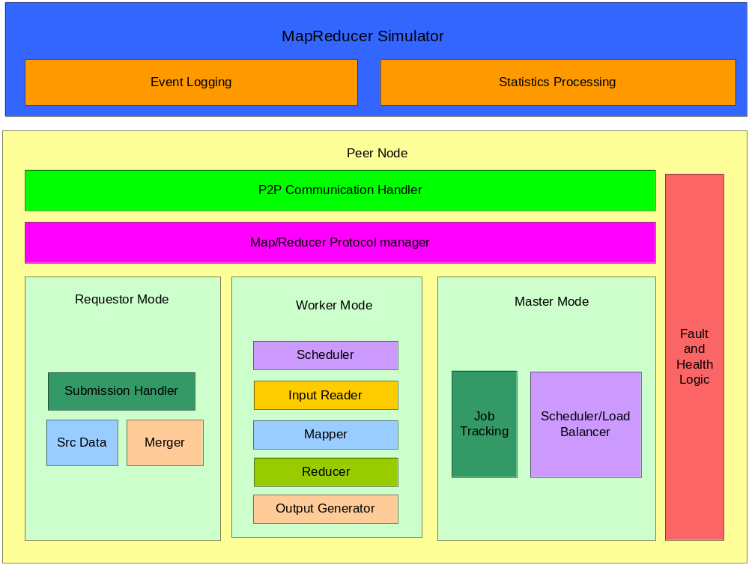
Approach – System Architecture

Slide 16
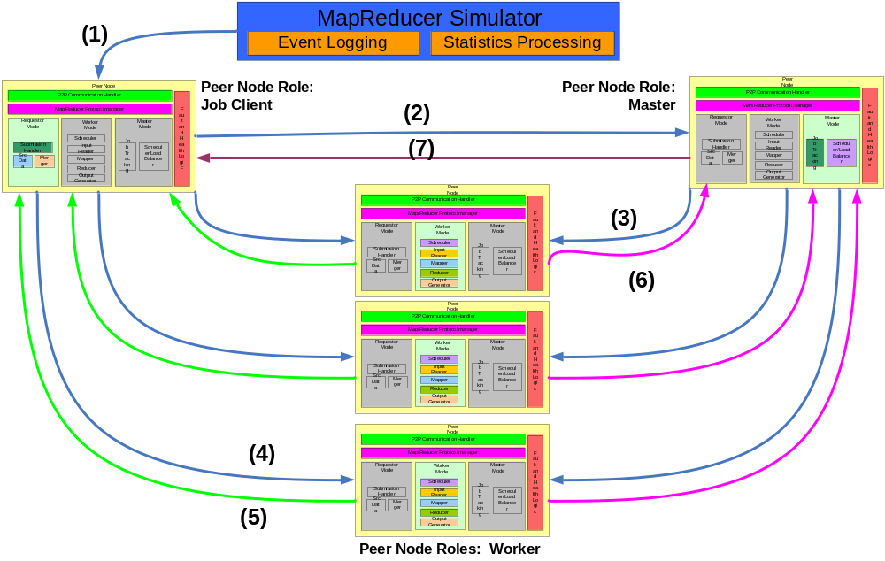
The simulation process makes a direct call into a “job client” node to start a MapReduce job on a certain file.

Slide 17
The “job client” sends a message to the current “master” node to tell it that it wants to submit the job.

Slide 18

The “master” analyzes the job, selects a number of “worker” nodes that should work on different chunks, and sends messages to each of these “workers” to tell them about their upcoming task.

Slide 19

Each “worker” receives the news about the chunks they are receiving. Each sends a message to the “job client”, which will be holding the input file the entire time, and request their chunk.

Slide 20
The “worker”, upon receiving their chunk, will begin processing it based on how it knows to complete this type of job.

Slide 21
When the MapReduce job has been completed, the “worker” will send the manipulated chunk back to the “job client”.

Slide 22
Each “worker” will then send a message to the “master” to inform them that they have completed their MapReduce task and sent the chunk back to the “job client”.

Slide 23

The “master” will send a message to the “job client” indicating that the MapReduce job is complete and that all chunks have been delivered back to it. The “job client” is responsible for merging the results of the job.

Slide 24
Approach – Self-* Algorithms
Self-healing is accomplished by monitoring the worker nodes and the master node.
  The “master” will monitor the “workers” by sending out a heartbeat type mechanism to all of them
  The “worker” nodes will all monitor and respond to the heartbeat
  A “worker” node will be declared failed by the “master” if it fails to respond to the heartbeat after several heart beat cycles
  The “master” will be declared failed if a few neighboring worker nodes determine that they have not received a heartbeat from the master after a period of time

Slide 25
Approach – Self-* Algorithms
Self-Healing (continued):
  If a worker node fails due to loss of connectivity to the network, other fatal conditions, or from running very poorly, the failed node’s computation will be re-distributed to a healthy node
  If the master node fails, one of the other peers will take over as the master node and then continue the MapReduce operation from where it left off.
  Therefore, the overall computation can seamlessly complete despite the failures

Slide 26
Approach – Self-* Algorithms
Self-configuration is accomplished by the peer nodes negotiating who will act as the master and the remaining nodes will be dynamically allocated as workers depending on the size of the MapReduce operation
  Workers will be recruited and selected by the master based on if they are functioning and if they are needed for the job’s size

Slide 27
Approach – Self-* Algorithms
Self-configuration (continued):
  The master will have a list of workers based on an algorithm using neighbors and using broadcasts
  In order to evaluate the effects of self-configuration, the tasks are monitored to ensure they are completed correctly even in the midst of failures, inefficiencies, and re-configurations

Slide 28
Approach – Future Work
In the simulation system, each node runs as a thread under the control of the simulator and communicates via method calls, rather than sockets
The system only focused on detecting nodes that fail or disconnect. In the future, efficiency values for each node will be computed and these will be used. Therefore, nodes can be considered “failed” even if they are connected, if they have a low efficiency value

Slide 29
Evaluation
Several scenarios were developed and used to test the system
There are scenarios to test the traditional MapReduce system against the system described here and scenarios that were run to tests the two Self-* applications and their implementation

Slide 30
Evaluation – Testing Basic M/R Implementation
Tested the system without any Self-* implementation. The goal of these tests was to obtain a baseline performance in order to evaluate the effects of adding in the Self-* implementation.
Simulation Type | Time From Submission to Completion
3 worker node system | 12.410 Seconds (Avg)
6 worker node system | 13.312 Seconds (Avg)

Slide 31
Evaluation – Testing the Addition of Self-*
The second set of tests simply test the benefits of the two self-* algorithms, by running a successful scenario and scenarios with different nodes failing and self-* algorithms correcting the problems.
Scenario | Time From Submission to Completion
No Failures (3 workers) | 13.975 Seconds (Avg)
No Failures (6 workers) | 22.106 Seconds (Avg)
One Worker Failure (3 workers) | 25.870 Seconds (Avg)
One Master Failure (3 workers) | 15.628 Seconds (Avg)

Slide 32
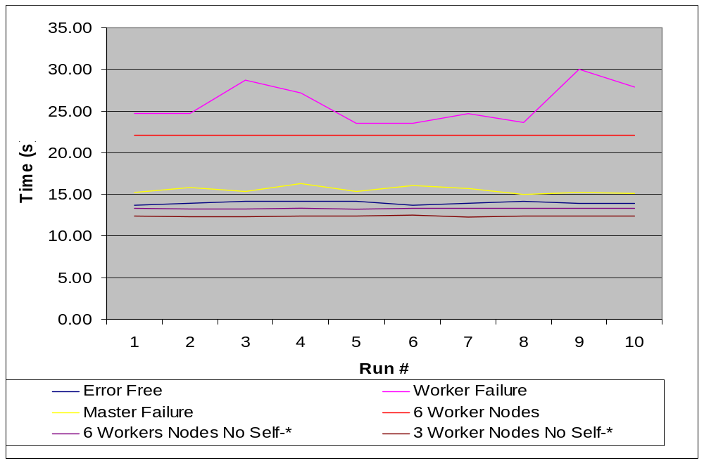
Evaluation – Testing the Addition of Self-*

Slide 33
Evaluation – System Demo
Scenario with no failures
Scenario with Master failure
Scenario with Worker failure

Slide 34
Related Work
Hadoop - Java framework using MapReduce
  Currently used in Yahoo web searches.
  Based on a network of computers connected via a local network rather than P2P. It also is a centralized system.
SETI@home - incorporates a centralized master node which distributes chunks of work to a P2P network of workers
  Worker nodes can only be workers, so there is no option for recovery if the master fails
  Jobs can only be submitted from the central system.

Slide 35
Related Work
Skynet - de-centralized, open source Ruby implementation of Google’s MapReduce framework
  It is adaptive, fault tolerant, and has only worker nodes.
  If the master fails, it has mechanisms to reassign its responsibilities, but only certain other nodes can take over for it
  As a non-P2P system, tasks that fail on a particular node can only be reassigned within a defined set of workers.
  There are no outside job submissions or processing available.

Slide 36
Related Work
In [4], a similar topology to this paper’s is described
  The authors discuss master failure and recovery as well as worker failure and recovery
  One key difference is that this system will only have one master. This approach will allow more available workers and still maintain the same level of functionality
  Some of the fault tolerance ideas from [4] will be used

Slide 37
Conclusions
MapReduce systems have many pitfalls, such as a centralized master, limited resources, and inability to easily recover from failures.
The de-centralized Peer-to-Peer MapReduce simulation system with self-configuration and self-healing produced by this paper’s team take large leaps towards addressing all of these issues.

Slide 38
Conclusions
All of the problems of a typical MapReduce system are solved by this new architecture. There are no single points of failure, the data and control (master) are de-centralized, there are limitless resources to choose from to run job submissions with the ideal number of nodes, and failures are quickly addressed.
The simulation system created and the tests and their results show that there are significant time gains from the self-* algorithms in place, under different failures. It also shows that this new system performs better with limitless nodes to choose from.

Slide 39
Conclusions
The work can be further extended by improving upon the team’s simulation system, implementing more components of it to remove assumptions it currently makes
Other than improving the simulation, actual real-world Peer-to-Peer network systems and more testing and evaluation could be used to validate the results of this paper.

Slide 40
References
Cardona, K., Secretan, J., Georgiopoulos, M., and Anagnostopoulos, G. 2007. A Grid based system for data mining using MapReduce. http://cygnus.fit.edu/amalthea/pubs/Cardona_Secretan_TR-2007-02_AMALTHEA.pdf
Dean, J., and Ghemawat, S. MapReduce: Simplified Data Processing on Large Clusters. Communications of the ACM, Vol. 51, No. 1, January 2008, pp. 107-113. http://www.scribd.com/doc/240523/MapReduce-Simplified-Data-Processing-on-Large-Clusters
Hadoop, http://hadoop.apache.org/core/
Marozzo, F.,Talia, D., and Trunfio, P. Adapting MapReduce for Dynamic Environments Using a Peer-to-Peer Model. Extended Abstract. http://www.cca08.org/papers/Poster7-Domenico-Talia.pdf
SETI@Home, http://setiathome.berkeley.edu
Skynet, http://rubyforge.org/projects/skynet
Yang, H., Dasdan, A., Hsiao, R., and Parker, D. Map-Reduce-Merge: Simplified Relational Data Processing on Large-Scale Clusters. SIGMOD’07, June 12-14, 2007, pp. 1029-1040.

